Slide 1
Unsupervised Deep Learning ZG533
Dr. Sugata Ghosal
sugata.ghosal@pilani.bits-pilani.ac.in

Slide 2
Session 7
These slides are prepared by the instructor, with grateful acknowledgement of many others who made their course materials freely available online.

Slide 3
Likelihood Based Model: Flow Models
Readings:
Simon D. Prince, Understanding Deep Learning, Chapter 16
Normalizing Flow Blog
Normalizing Flow Tutorial
https://github.com/udlbook/udlbook/tree/main/Notebooks/Chap16

Slide 4
Lecture overview
Foundations of Flows (1-D)
2-D Flows
N-D Flows
Autoregressive Flows and Inverse Autoregressive Flows
RealNVP (like) architectures
Glow, Flow++, FFJORD
Dequantization

Slide 5


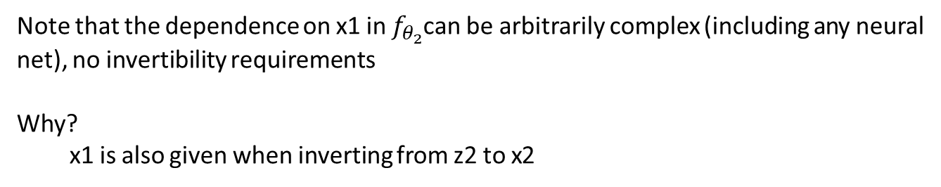
2-D Autoregressive Flow
Note that the dependence on x1 in $f_{θ_{2}}$can be arbitrarily complex (including any neural net), no invertibility requirements
Why?
x1 is also given when inverting from z2 to x2

Slide 6
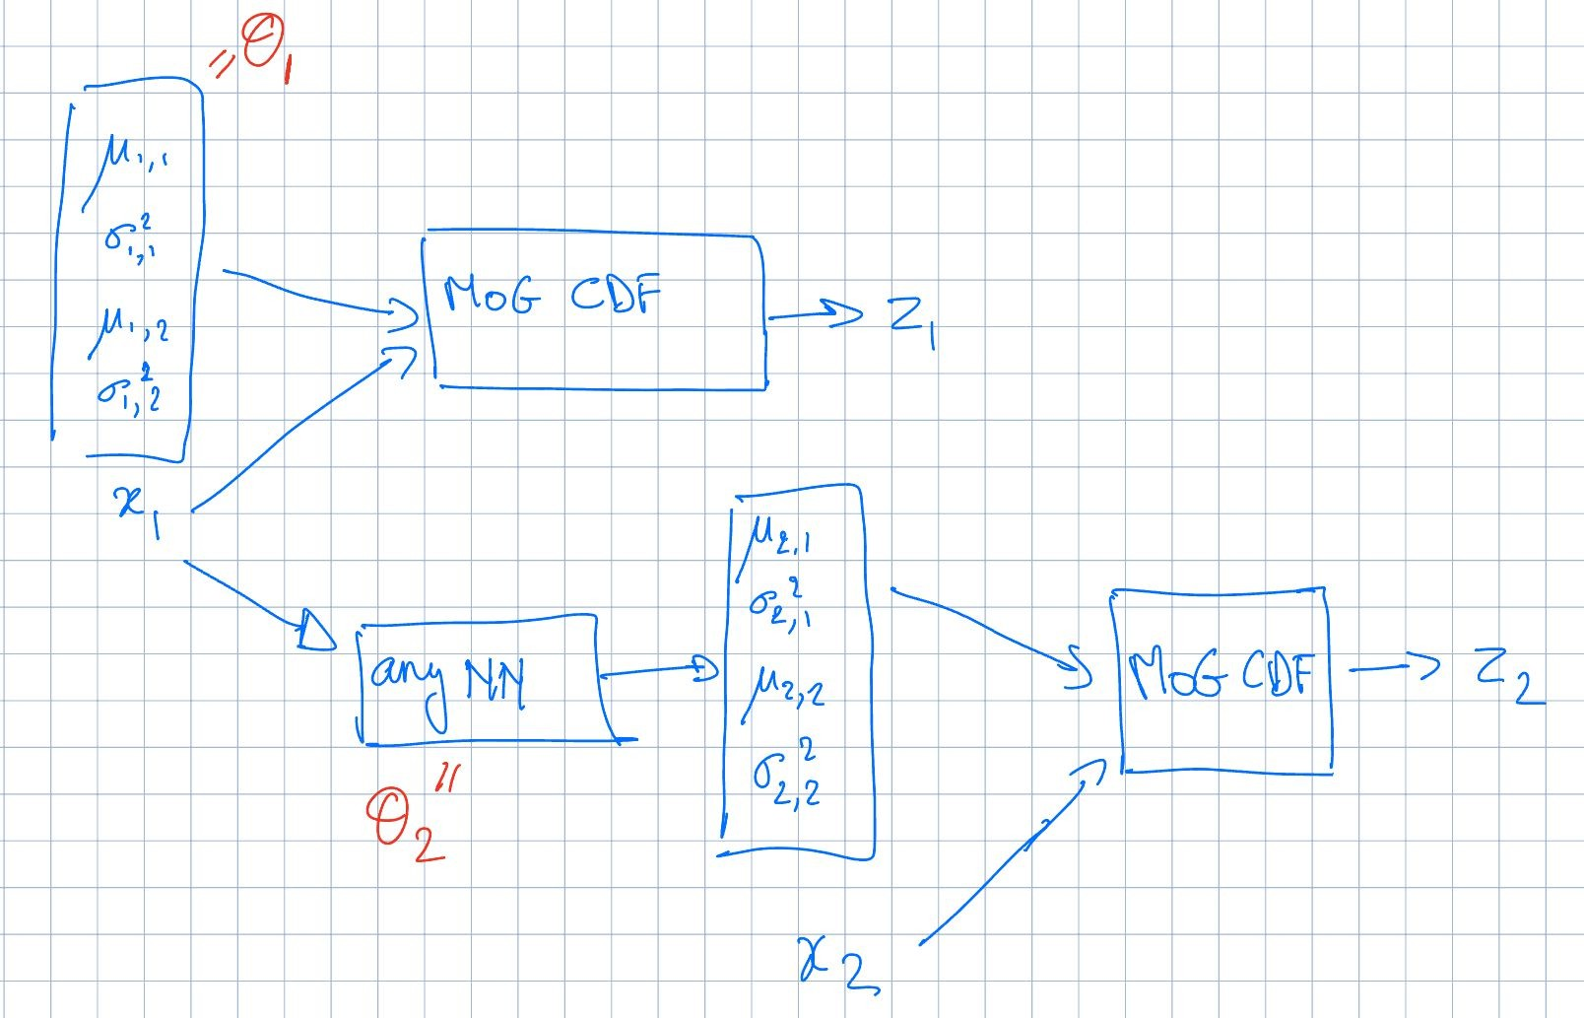
Example 2-D Autoregressive Flow

Slide 7
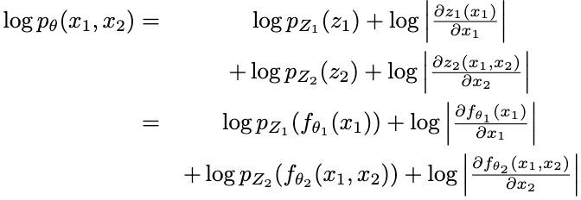
Training Objective

Slide 8
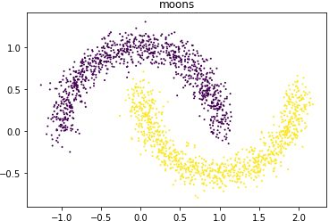
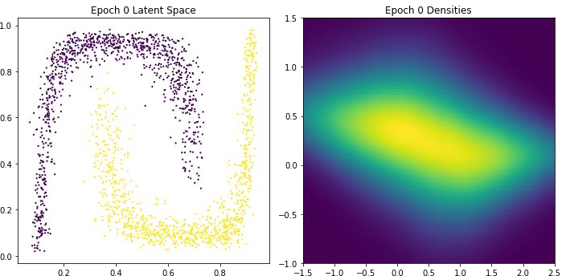
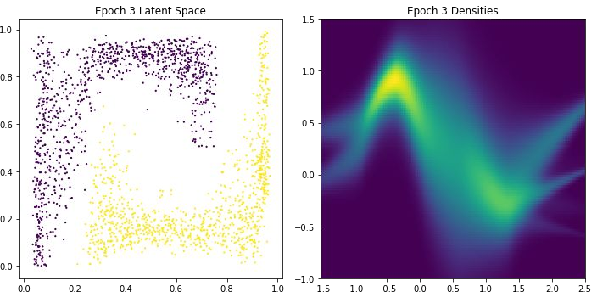
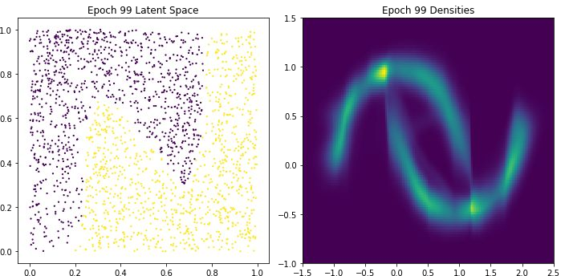
2-D Autoregressive Flow: Two Moons
Architecture:
Base distribution: Uniform[0,1]^2
x1: mixture of 5 Gaussians
i.e. z1 = cdf of Mo5G
x2: mixture of 5 Gaussians, conditioned on x1
I.e. z2 = cdf of Mo5G with mixture weights w, means mu, variances sigma conditioned on x1. I.e. arbitrary NN can be trained to map from x1 to w, mu, sigma

Slide 9
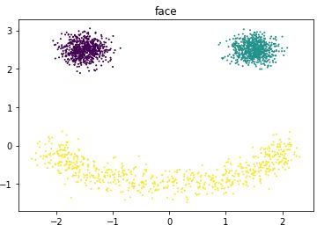
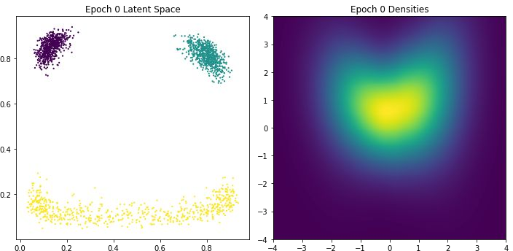
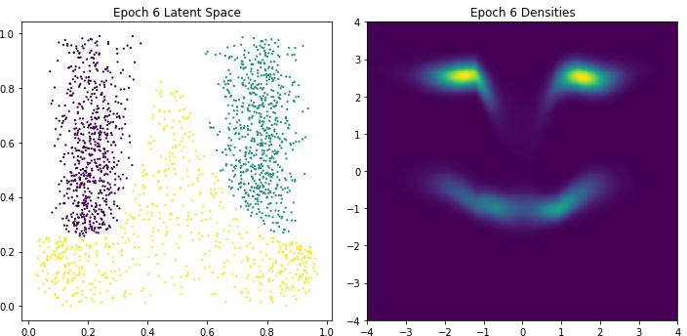
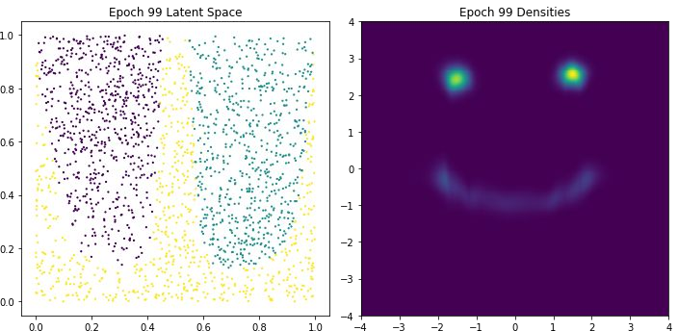
2-D Autoregressive Flow: Face
Architecture:
Base distribution: Uniform[0,1]^2
x1: mixture of 5 Gaussians
x2: mixture of 5 Gaussians, conditioned on x1

Slide 10
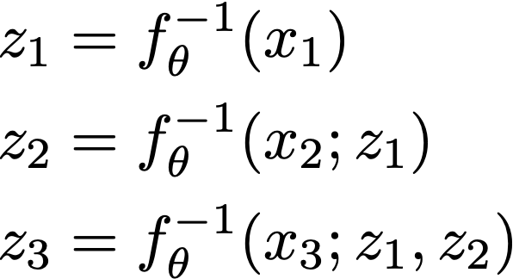
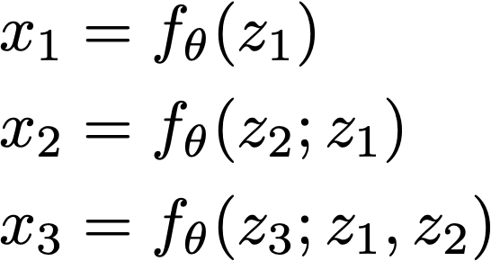
Inverse autoregressive flows
The inverse of an autoregressive flow is also a flow, called the inverse autoregressive flow (IAF)
x → z has the same structure as the sampling in an autoregressive model
z → x has the same structure as log likelihood computation of an autoregressive model. So, IAF sampling is fast
Sequential/Slow Training
Parallel/Fast Sampling

Slide 11
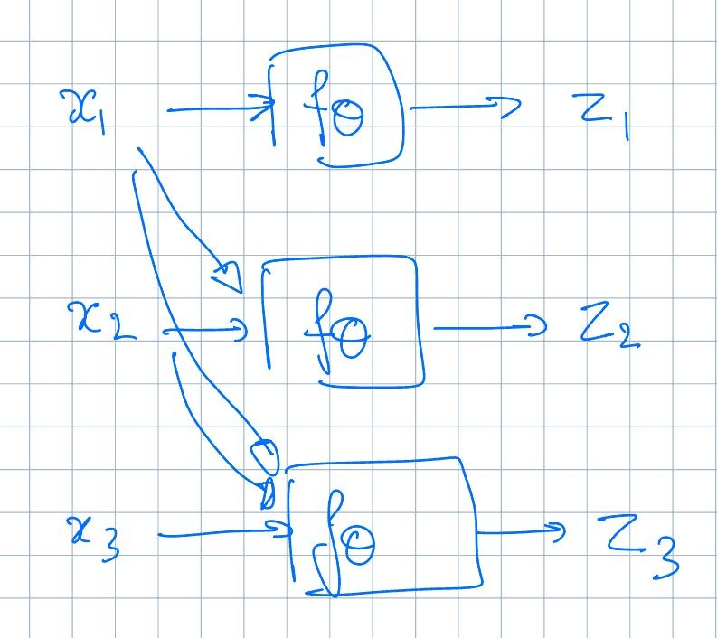
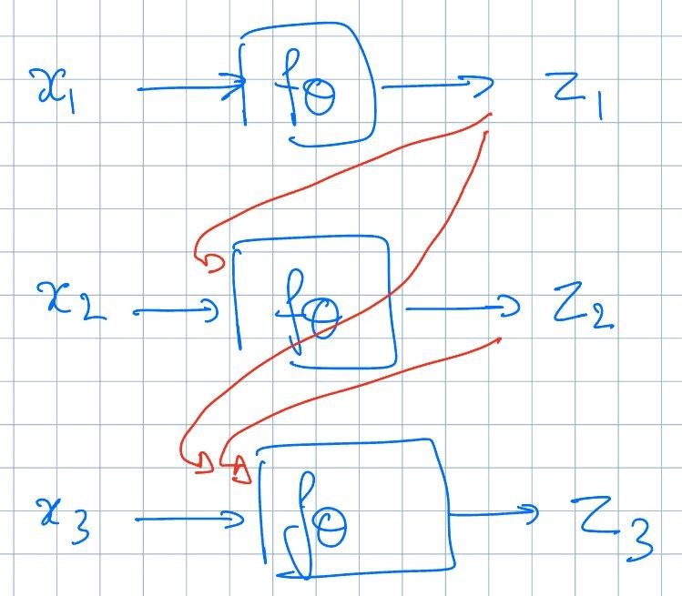
AF
IAF
Training: parallel / fast Sampling: long serial chain
Training: long serial chain Sampling: parallel / fast

Slide 12
AF vs IAF
Autoregressive flow
Fast evaluation of p(x) for arbitrary x
Slow sampling
Inverse autoregressive flow
Slow evaluation of p(x) for arbitrary x, so training directly by maximum likelihood is slow.
Fast sampling
Fast evaluation of p(x) if x is a sample
There are models (Parallel WaveNet, IAF-VAE) that exploit IAF’s fast sampling

Slide 13
Best of both AF and IAF
Key idea:
Train AF -> FAST
Distillation:
Sample from AF, keep activations (bit slow..)
Train IAF on the samples using access to activations -> FAST

Slide 14
AF and IAF
Naively, both end up being as deep as the number of variables!
- e.g. 1MP image → 1M layers…
Can do parameter sharing as in Autoregressive Models [e.g. RNN, masking]

Slide 15
Parallel Wavenet
Two part training with a teacher and student model
Teacher is parameterized by MAF. Teacher can be efficiently trained via MLE
Once teacher is trained, initialize a student model parameterized by IAF. Student model cannot efficiently evaluate density for external datapoints but allows for efficient sampling
Key observation: IAF can also efficiently evaluate densities of its own generations (via caching the noise variates z₁, z₂, . . . , z_{n})

Slide 16
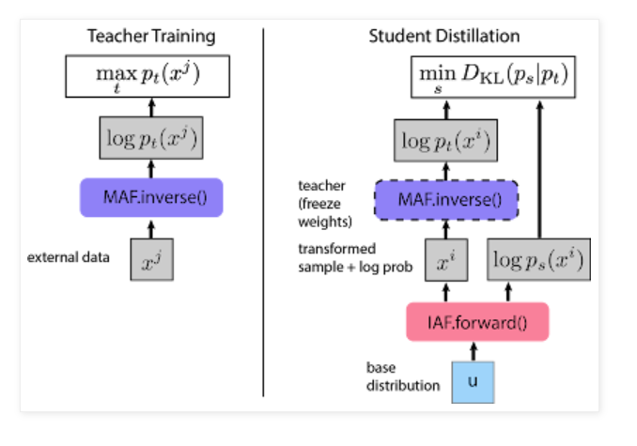
https://deepmind.google/discover/blog/high-fidelity-speech-synthesis-with-wavenet/

Slide 17
Parallel Wavenet
Probability density distillation: Student distribution is trained to minimize the KL divergence between student (s) and teacher (t)
D_{KL}(s, t) = E_{x∼s} [log s(x) − log t(x)]
Evaluating and optimizing Monte Carlo estimates of this objective requires:
Samples x from student model (IAF)
Density of x assigned by student model
Density of x assigned by teacher model (MAF)
All operations above can be implemented efficiently

Slide 18
Parallel Wavenet: Overall
Training
Step 1: Train teacher model (MAF) via MLE
Step 2: Train student model (IAF) to minimize KL divergence with teacher
Test-time: Use student model for testing
Improves sampling efficiency over original Wavenet (vanilla autoregressive model) by 1000x!

Slide 19
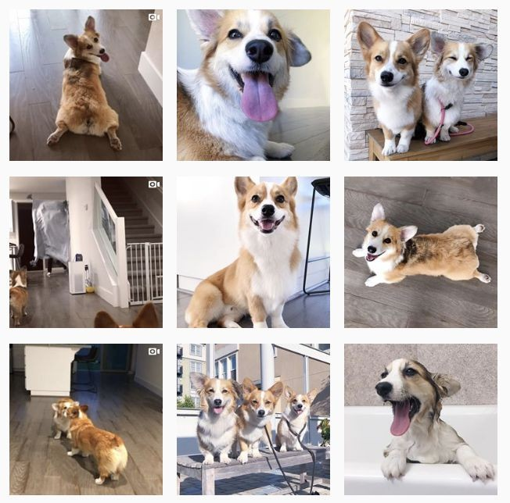
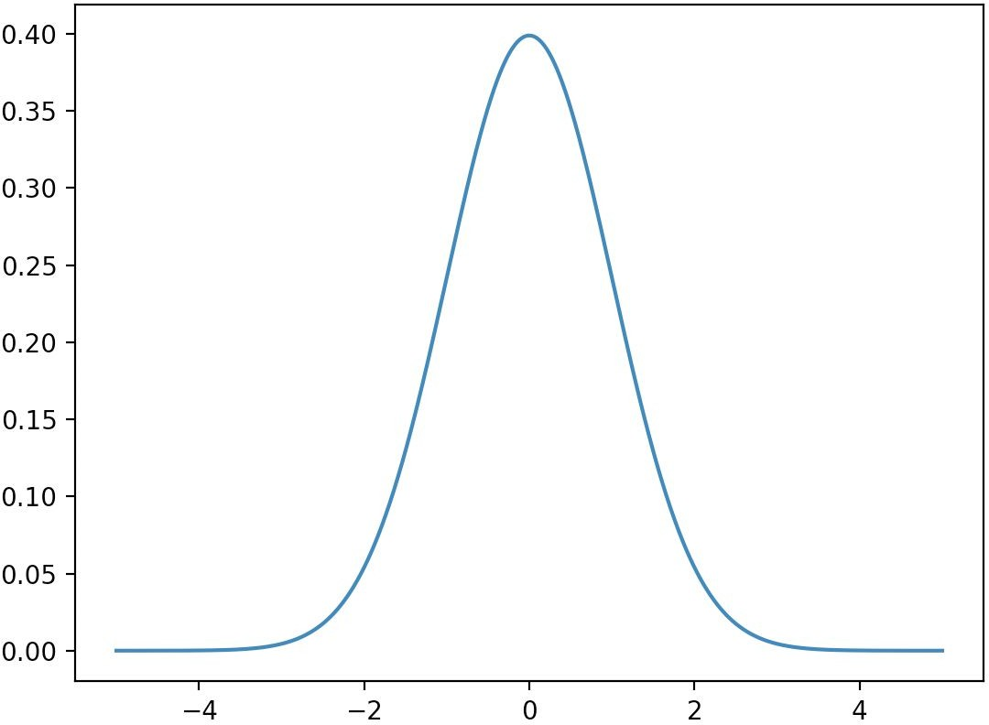


High-dimensional data
f (inference)
f⁻¹ (sampling)
x and z must have the same dimension

Slide 20
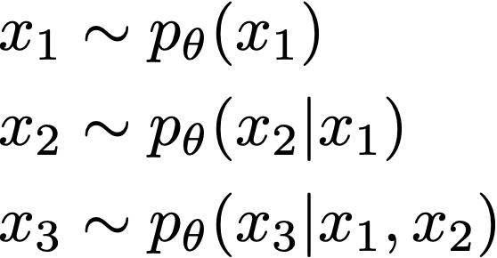
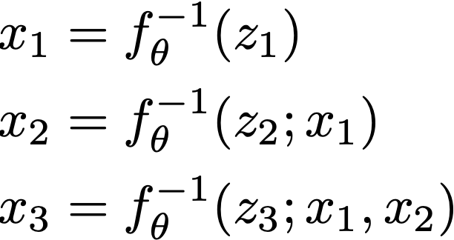
N-D Autoregressive flows
The sampling process of a Bayes net is a flow
If autoregressive, this flow is called an autoregressive flow
Sampling is an invertible mapping from z to x

Slide 21
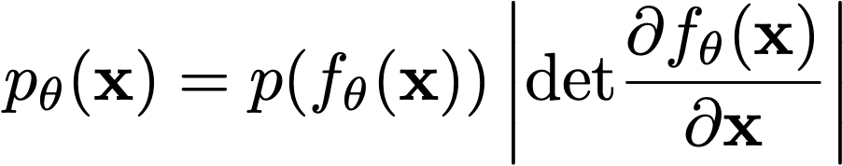
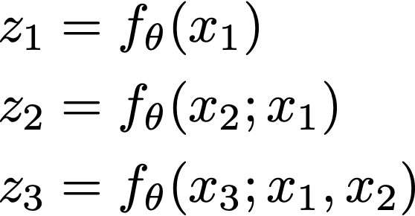
Autoregressive flows
How to fit autoregressive flows?
Map x to z
Fully parallelizable
Notice
x → z has the same structure as the log likelihood computation of an autoregressive model
z → x has the same structure as the sampling procedure of an autoregressive model

Slide 22
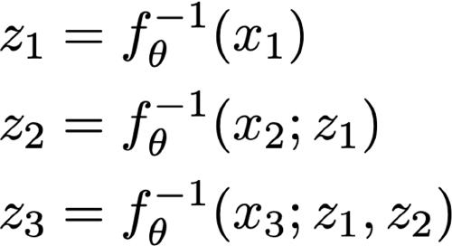
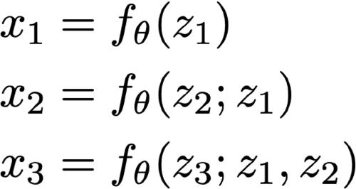
Inverse autoregressive flows
The inverse of an autoregressive flow is also a flow, called the inverse autoregressive flow (IAF)
x → z has the same structure as the sampling in an autoregressive model
z → x has the same structure as log likelihood computation of an autoregressive model. So, IAF sampling is fast

Slide 23
Autoregressive models as flow models
Consider a Gaussian autoregressive model:
n
p(x) = p(x |x )
Σ
i <i
i =1
such that p(x_{i} | x_{<i} ) = N(µ_{i} (x₁, · · · , x_{i −1}), exp(α_{i} (x₁, · · · , x_{i −1}))²). Here, µ_{i} (·) and α_{i} (·) are neural networks for i > 1 and constants for i = 1.
Sampler for this model:
Sample z_{i} ∼ N (0, 1) for i = 1, … , n
Let x₁ = exp(α₁)z₁ + µ₁. Compute µ₂(x₁), α₂(x₁)
Let x₂ = exp(α₂)z₂ + µ₂. Compute µ₃(x₁, x₂), α₃(x₁, x₂)
Let x₃ = exp(α₃)z₃ + µ₃. ...
Flow interpretation: transforms samples from the standard Gaussian (z₁, z₂, . . . , z_{n}) to those generated from the model (x₁, x₂, . . . , x_{n}) via invertible transformations (parameterized by µ_{i} (·), α_{i} (·))

Slide 24
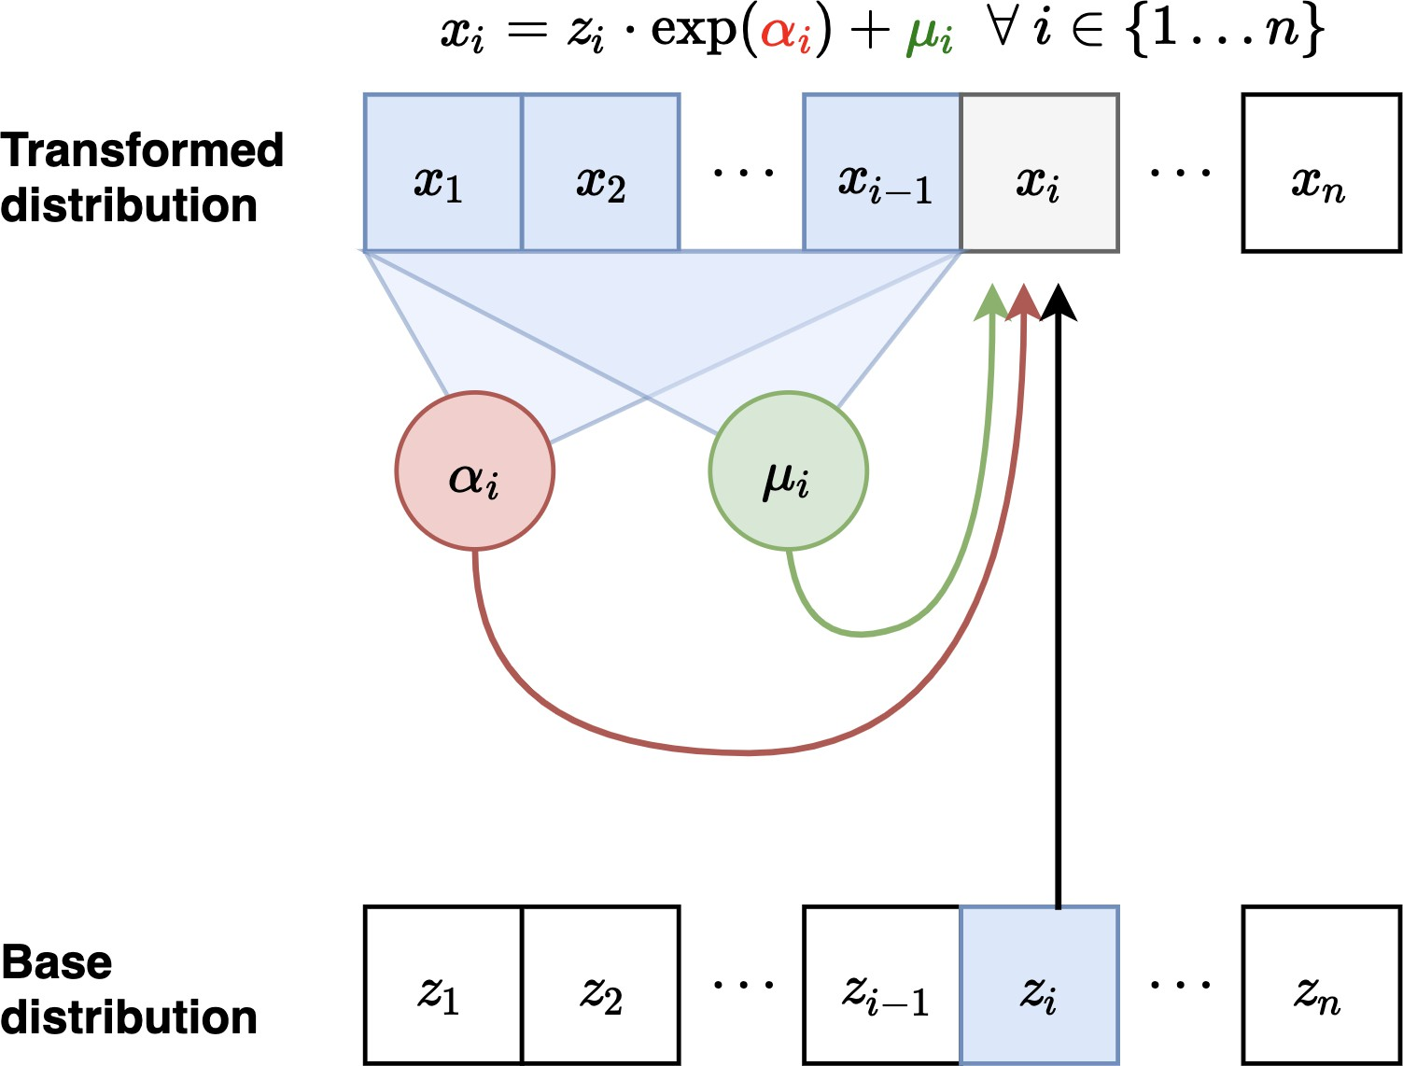
Masked Autoregressive Flow (MAF)
Forward mapping from z '→ x:
Let x₁ = exp(α₁)z₁ + µ₁. Compute µ₂(x₁), α₂(x₁)
Let x₂ = exp(α₂)z₂ + µ₂. Compute µ₃(x₁, x₂), α₃(x₁, x₂)
Sampling is sequential and slow (like autoregressive): O(n) time
Figure adapted from Eric Jang’s Tutorial

Slide 25
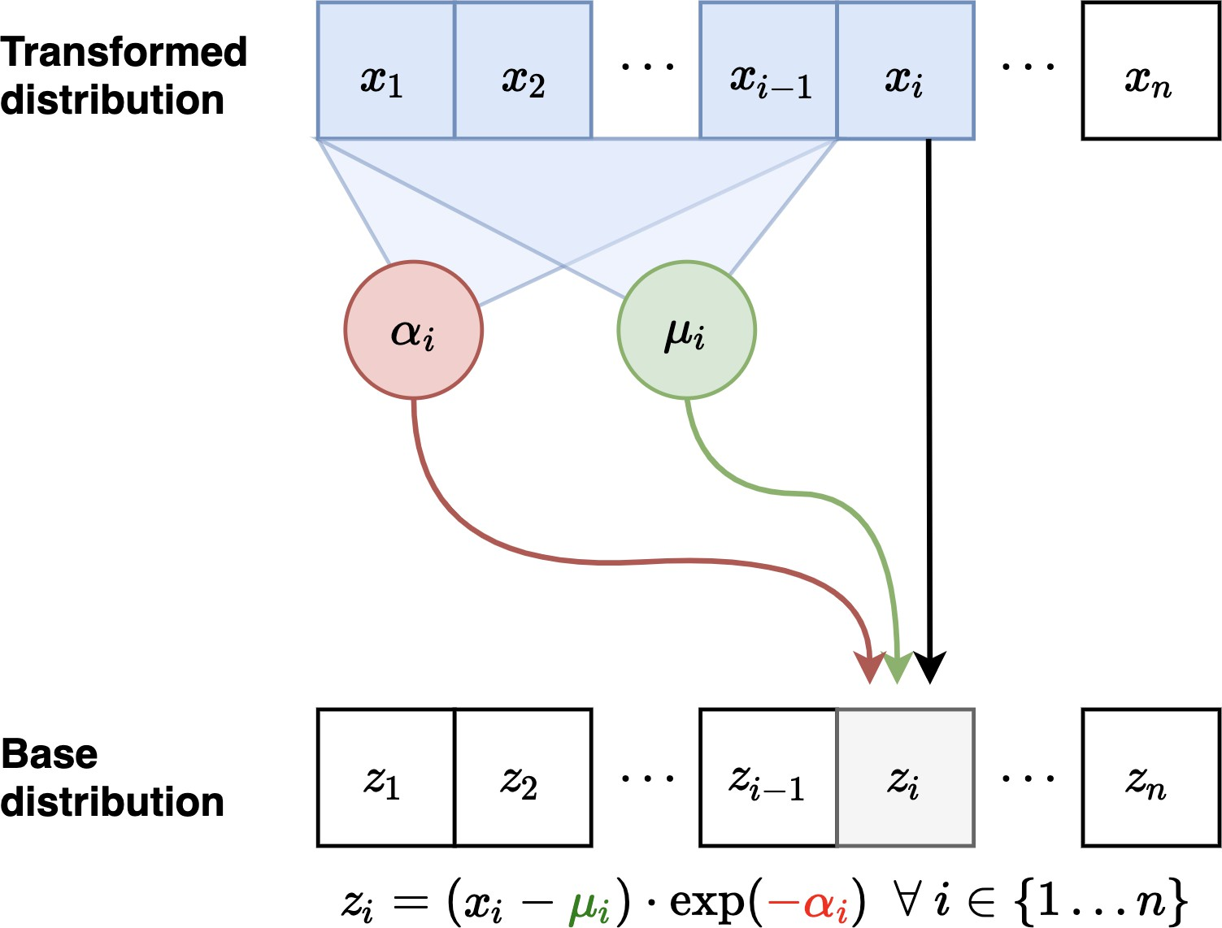
Masked Autoregressive Flow (MAF)
Inverse mapping from x '→ z:
Compute all µ_{i} , α_{i} (can be done in parallel using e.g., MADE)
Let z₁ = (x₁ − µ₁)/ exp(α₁) (scale and shift)
Let z₂ = (x₂ − µ₂ )/ exp(α₂)
Let z₃ = (x₃− µ₃ )/ exp(α₃) …
Jacobian is lower diagonal, hence efficient determinant computation Likelihood evaluation is easy and parallelizable (like MADE)
Layers with different variable orderings can be stacked
Figure adapted from Eric Jang’s Tutorial

Slide 26
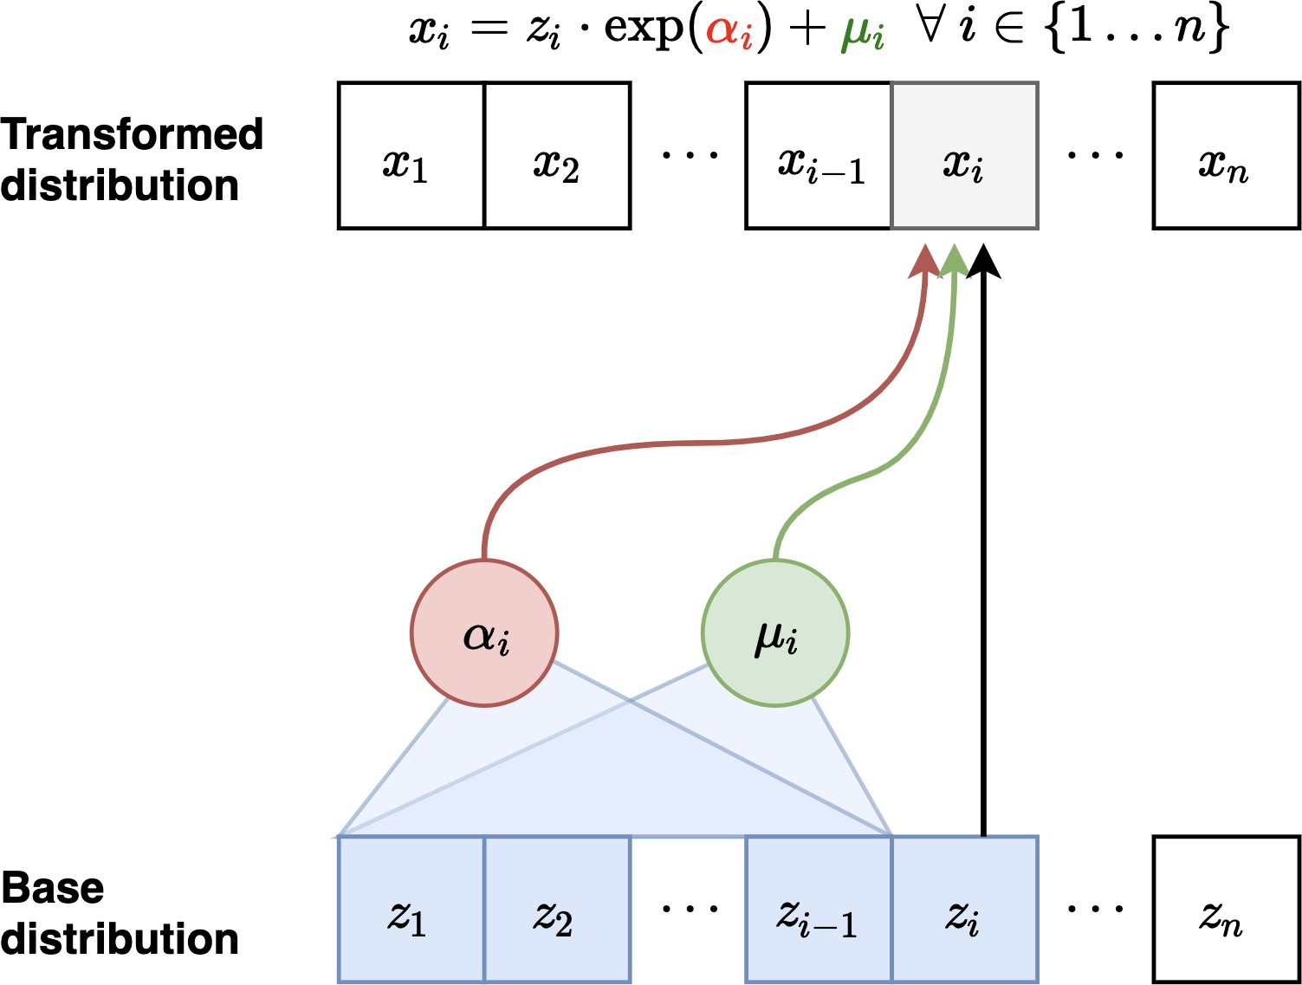
Inverse Autoregressive Flow (IAF)
Forward mapping from z → x (parallel): Sample z_{i} ∼
N (0, 1) for i = 1, …, n
Compute all µ_{i} , α_{i} (can be done in parallel)
Let x₁ = exp(α₁)z₁ + µ₁
Let x₂ = exp(α₂)z₂ + µ₂ ...
Inverse mapping from x → z (sequential):
Let z₁ = (x₁ − µ₁)/ exp(α₁). Compute µ₂(z₁), α₂(z₁)
Let z₂ = (x₂ − µ₂)/ exp(α₂). Compute µ₃(z₁, z₂), α₃(z₁, z₂)
Fast to sample from, slow to evaluate likelihoods of data points
Note: Fast to evaluate likelihoods of a generated point (cache z₁, z₂, . . . , z_{n} )
Figure adapted from Eric Jang’s blog

Slide 27
IAF is inverse of MAF
Inverse pass of MAF (left) vs. Forward pass of IAF (right)
Interchanging z and x in the inverse transformation of MAF gives the forward transformation of IAF
Similarly, forward transformation of MAF is inverse transformation of IAF

Slide 28

AF vs IAF
Autoregressive flow
Fast evaluation of p(x) for arbitrary x
Slow sampling
Inverse autoregressive flow
Jacobian
(Lower triangular)
Slow evaluation of p(x) for arbitrary x, so training directly by maximum likelihood is slow.
Fast sampling
Fast evaluation of p(x) if x is a sample
There are models (Parallel WaveNet, IAF-VAE) that exploit IAF’s fast sampling

Slide 29



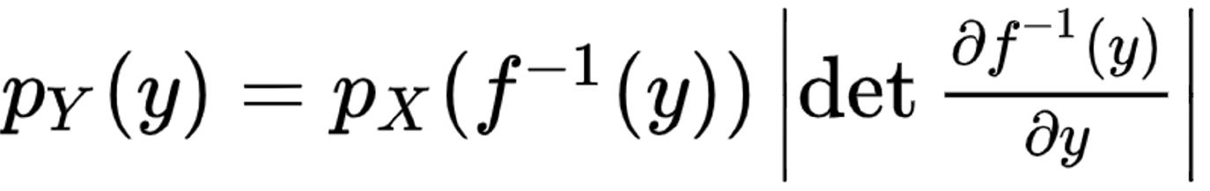
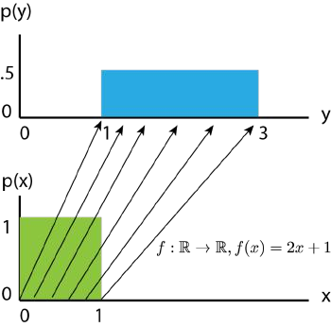
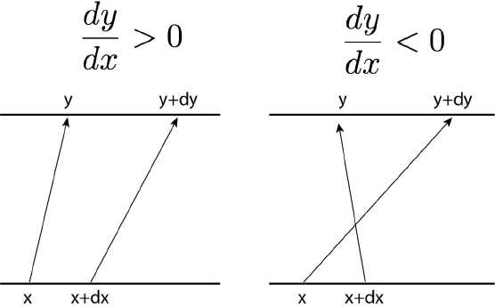
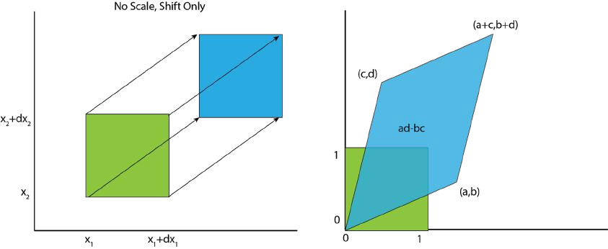
Refresher: Change of MANY variables
For a multivariable invertible mapping
1-D
2-D
Figures from blog post: Normalizing Flows Tutorial, Part 1: Distributions and Determinants by Eric Jang

Slide 30
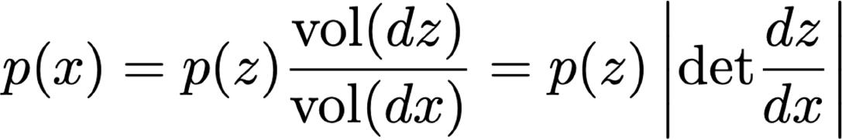
Change of MANY variables
For z ~ p(z), sampling process f⁻¹ linearly transforms a small cube dz to a small parallelepiped dx. Probability is conserved:
Intuition: x is likely if it maps to a “large” region in z space

Slide 31
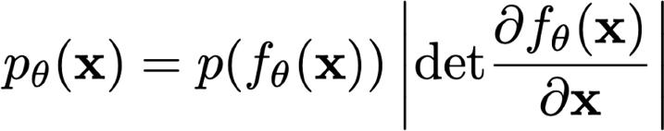
Flow models: training
Change-of-variables formula lets us compute the density over x:
Train with maximum likelihood:
New key requirement: the Jacobian determinant must be easy to calculate and differentiate!

Slide 32


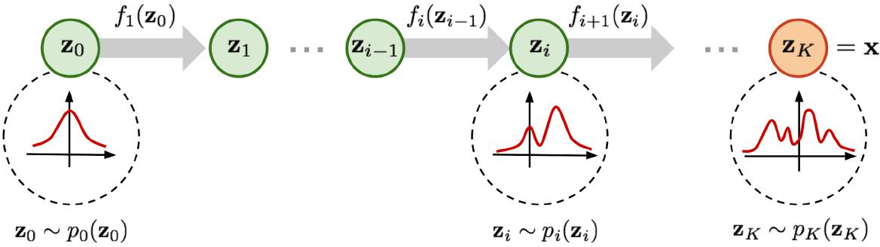
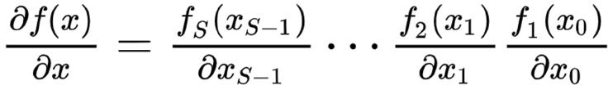
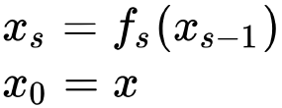
Chaining Invertible Mappings
Chain rule
Determinant of matrix product
Figure from blog post: Flow-based Deep Generative Models by Lilian Weng, 2018
44

Slide 33
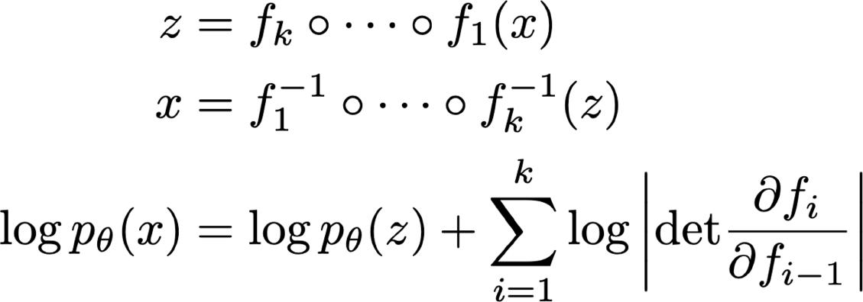
Constructing flows: composition
Flows can be composed
x → f₁ → f₂ → … f_{k} → z
Easy way to increase expressiveness

Slide 34
Affine flows
Another name for affine flow: multivariate Gaussian.
Parameters: an invertible matrix A and a vector b
f (x) = A^{—1}(x — b)
Sampling:
x = Az + b , where z ⇠ N (0, I)
x ⇠ N (b, AA^{T} )
Log likelihood is expensive when dimension is large.
The Jacobian of f is A^{—1}
Log likelihood involves calculating det(A)

Slide 35
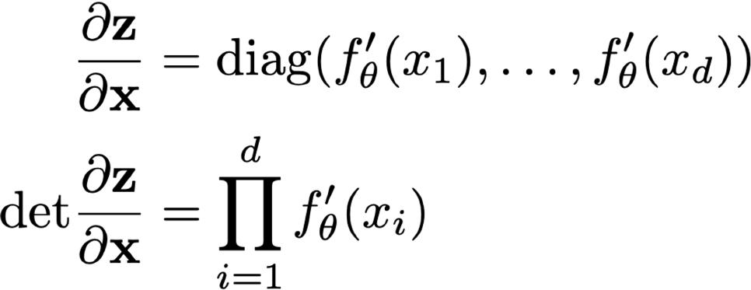
Elementwise flows
Lots of freedom in elementwise flow
– Can use elementwise affine functions or CDF flows.
The Jacobian is diagonal, so the determinant is easy to evaluate.

Slide 36
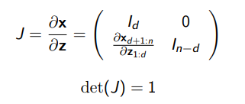
NICE - Additive coupling layers
Partition the variables z into two disjoint subsets, say z_{1:d} and z_{d +1:n} for any 1 ≤ d < n
Forward mapping z '→ x:
x_{1:d} = z_{1:d} (identity transformation)
x_{d +1:n} = z _{d +1:n} + m_{θ} (z_{1:d} )
m_{θ} (·) is a neural network with parameters θ , d input units, and n − d output units
Inverse mapping x '→ z:
z_{1:d} = x_{1:d} (identity transformation)
z _{d +1:n} = x _{d +1:n} − m _{θ} (x _{1:d} )
Jacobian of forward mapping:
- Volume preserving transformation since determinant is 1.

Slide 37
NICE - Rescaling layers
Additive coupling layers are composed together (with arbitrary partitions of variables in each layer)
Final layer of NICE applies a rescaling transformation
Forward mapping z '→ x:
x_{i} = s_{i}z_{i}
where s_{i} > 0 is the scaling factor for the i -th dimension.
Inverse mapping x '→ z:
z =
x
i
i
s_{i}
Jacobian of forward mapping:
J = diag(s)
n
det(J) = π s
i
i =1

Slide 38
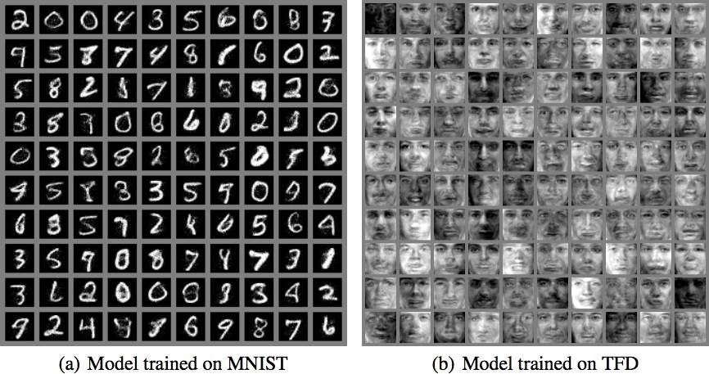
Samples generated via NICE

Slide 39
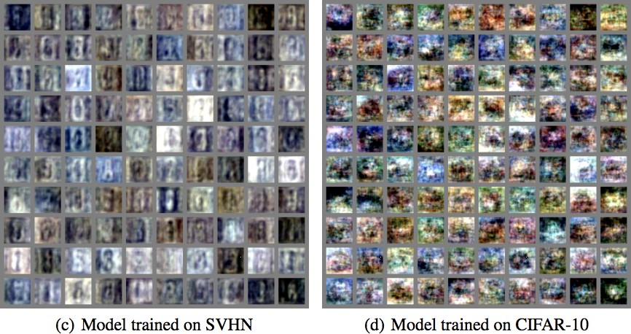
Samples generated via NICE

Slide 40
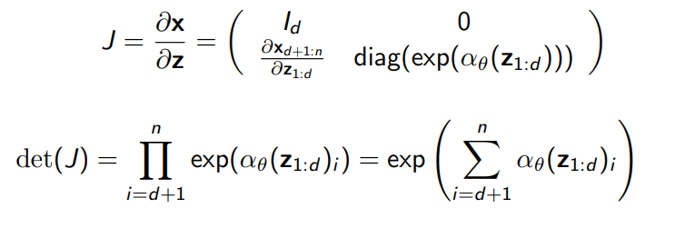
Real-NVP: Non-volume preserving NICE
Forward mapping z '→ x:
x_{1:d} = z_{1:d} (identity transformation)
x_{d +1:n} = z_{d +1:n} ⊙ exp(α_{θ} (z_{1:d} )) + µ_{θ} (z_{1:d} )
µ_{θ} (·) and α_{θ} (·) are both neural networks with parameters θ, d input units, and n − d output units [⊙ denotes elementwise product]
Inverse mapping x '→ z:
z_{1:d} = x_{1:d} (identity transformation)
z_{d +1:n} = (x_{d +1:n} − µ_{θ} (x_{1:d} )) ⊙ (exp(−α_{θ} (x_{1:d} )))
Jacobian of forward mapping:
Non-volume preserving transformation in general since determinant can be < > 1

Slide 41
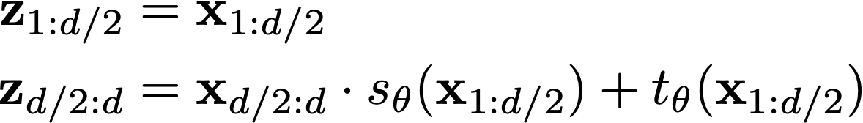
RealNVP
Affine coupling layer
Split variables in half: x_{1:d/2}, x_{d/2+1:d}
Invertible! Note that s_{θ} and t_{θ} can be arbitrary neural nets with no restrictions.
Think of them as data-parameterized elementwise flows.
http://www0.cs.ucl.ac.uk/staff/A.Sztrajman/webpage/blog/rnvp/rnvp.html

Slide 42

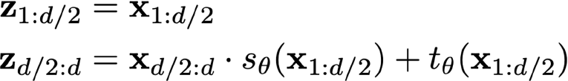
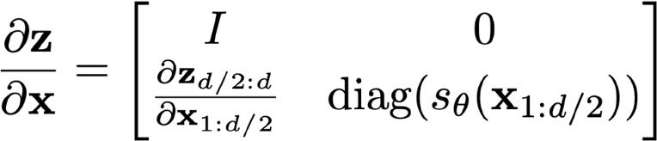
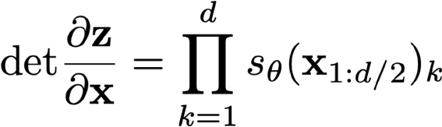
NICE/RealNVP
It also has a tractable Jacobian determinant
Jacobian
(Lower triangular
+ structured)
The Jacobian is triangular, so its determinant is the product of diagonal entries.

Slide 43
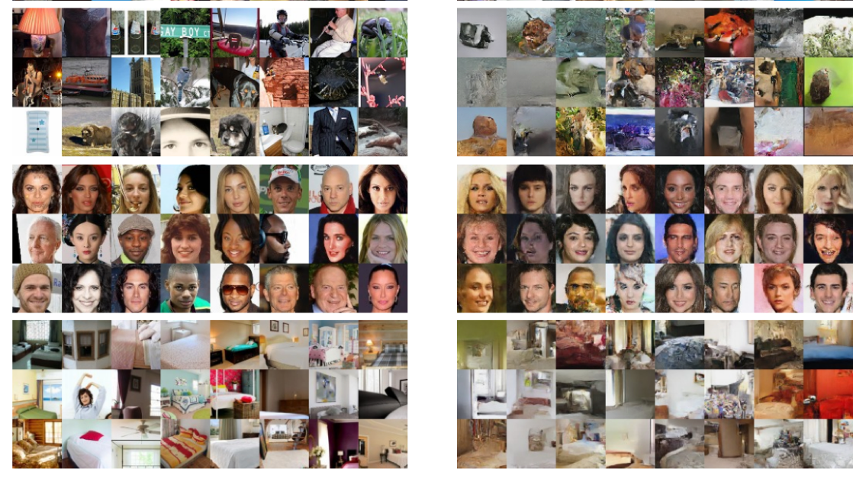
Samples generated via Real-NVP
Takeaway: coupling layers allow unrestricted neural nets to be used in flows, while preserving invertibility and tractability

Slide 44
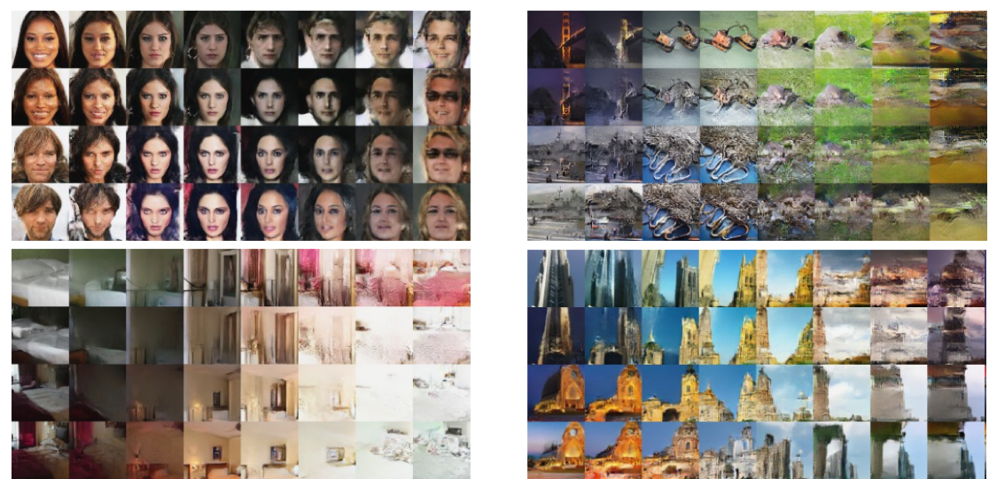
Latent space interpolations via Real-NVP
Using with four validation examples z⁽¹⁾, z⁽²⁾, z⁽³⁾, z⁽⁴⁾, define interpolated z as:
z = cosϕ(z⁽¹⁾cosϕ′ + z⁽²⁾sinϕ′) + sinϕ(z⁽³⁾cosϕ′ + z⁽⁴⁾sinϕ′) with manifold parameterized by ϕ and ϕ′.

Slide 45
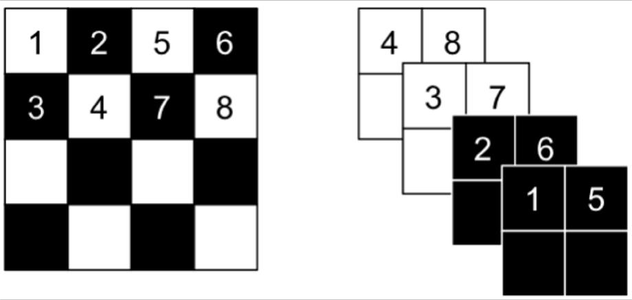
RealNVP: How to partition variables?
Partitioning can be implemented using a binary mask b, and using the functional form for y
f (x) = b ⊙ x + (1 — b) ⊙ (x ⊙ exp(s (b ⊙ x)) + m(b ⊙ x))
After a “squeeze” operation
The squeezing operation reduces the
4 × 4 × 1 tensor into a 2 × 2 × 4 tensor
The spatial checker board pattern mask has value 1 where the sum of spatial coordinates is odd, and 0 otherwise.
12
9 10 13 14
11 12 15 16
11
The channel-wise mask b is 1 for the first half of the channel dimensions and 0 for the second half.
^{x}d/2:d
10
9 13
https://bjlkeng.io/posts/normalizing-flows-with-real-nvp/
^{x}1:d/2
Figures from Density Estimation Using Real NVP by Dinh et al., 2017
53

Slide 46
RealNVP Architecture
Input x: 32×32×c image
Layer 1: (Checkerboard ×3, channel squeeze, channel ×3)
– Split result to get x₁: 16×16×2c and z₁: 16×16×2c (fine-grained latents)
Layer 2: (Checkerboard ×3, channel squeeze, channel ×3)
– Split result to get x₂: 8×8×4c and z₂: 8×8×4c (coarser latents)
Layer 3: (Checkerboard ×3, channel squeeze, channel ×3)
– Get z₃: 4×4×16c (latents for highest-level details)

Slide 47
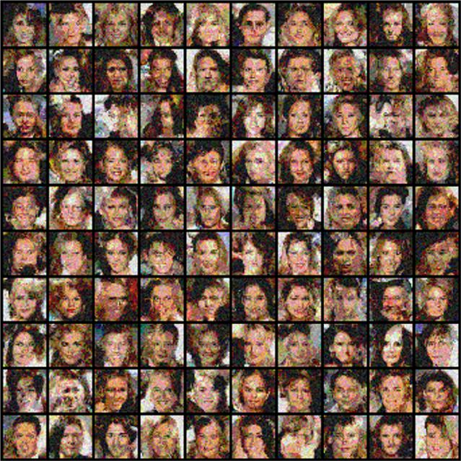

Good vs Bad Partitioning
Checkerboard ×4; channel squeeze; channel ×3; channel unsqueeze; checkerboard ×3
(Mask top half; mask bottom half; mask left half; mask right half) ×2

Slide 48

Choice of coupling transformation
A Bayes net defines coupling dependency, but what invertible transformation f to use is a design question
Affine transformation is the most commonly used one (NICE, RealNVP, IAF-VAE, …)
More complex, nonlinear transformations -> better performance
CDFs and inverse CDFs for Mixture of Gaussians or Logistics (Flow++)
Piecewise linear/quadratic functions (Neural Importance Sampling)

Slide 49

Flow++
Samples from Flow++ trained on 64x64 CelebA

Slide 50

NN architecture also matters
Flow++ = MoL transformation + self-attention in NN
– Bayes net (coupling dependency), transformation function class, NN architecture all play a role in a flow’s performance.

Slide 51

Other classes of flows
Glow (https://openai.com/index/glow/)
Invertible 1x1 convolutions
Large-scale training
Continuous time flows (FFJORD)
Allows for unrestricted architectures. Invertibility and fast log probability computation guaranteed.
1x1 Convolution in GLOW

Slide 52

Glow: Interpolation

Slide 53

Glow: Attribute Control

Slide 54

GLOW Animation

Slide 55






Architectural Taxonomy
Sparse connection
Residual Connection
1. Autoregressive
2. Block coupling
3. Det identity
4. Stochastic estimation
IAF/MAF/NAF
SOS polynomial UMNN
NICE/RealNVP/Glow Cubic Spline Flow Neural Spline Flow
Planar/Sylvester flows
Radial flow
Residual Flow FFJORD
Jacobian
(Lower triangular)
(Lower triangular + structured)
(Low rank)
(Arbitrary)

Slide 56


Flow on Discrete Data Without Dequantization...

Slide 57


Continuous flows for discrete data
A problem arises when fitting continuous density models to discrete data: degeneracy
When the data are 3-bit pixel values,
What density does a model assign to values between bins like 0.4, 0.42…?
Correct semantics: we want the integral of probability density within a discrete interval to approximate discrete probability mass

Slide 58



Continuous flows for discrete data
Solution: Dequantization. Add noise to data.
– We draw noise u uniformly from
[Theis, Oord, Bethge, 2016]
64

Slide 59



Flow on Discrete Data With Dequantization

Slide 60



Applications: Super-Resolution
SRFlow
A normalizing flow based super-resolution method, allowing diversity
Outperforms state-of-the-art GAN-based approaches

Slide 61



Application: Text Synthesis
Language Flow
– non-autoregressive and autoregressive flow-based models

Slide 62


Applications: Audio Synthesis
FloWaveNet
A flow-based generative model for raw audio synthesis
Efficiently samples raw audio in real-time

Slide 63


Applications: Point Cloud Generation
Mixture of Normalizing Flows for modeling 3D point clouds
Each mixture component learns to specialize in a distinct subregion in an unsupervised fashion.

Slide 64
Desiderata for flow models
Simple prior p_{Z} (z) that allows for efficient sampling and tractable likelihood evaluation.
e.g., isotropic Gaussian
Invertible transformations with tractable evaluation:
evaluation requires efficient evaluation of x' → z mapping
Sampling requires efficient evaluation of z' → x mapping
Computing likelihoods also requires the evaluation of determinants of n × n Jacobian matrices, where n is the data dimensionality
Computing the determinant for an n × n matrix is O(n³) - prohibitively expensive within a learning loop!
Key idea: Choose tranformations so that the resulting Jacobian matrix has special structure. For example, the determinant of a triangular matrix is the product of the diagonal entries, i.e., an O(n) operation

Slide 65
Future directions
The ultimate goal: a likelihood-based model with
fast sampling
fast inference
fast training
good samples
good compression
Flows seem to let us achieve some of these criteria.
But how exactly do we design and compose flows for great performance? That’s an open question.
Some requirements that might pose permanent challenges:
Dimensionality preserving
Invertibility
Cheap determinant

Slide 66
Bibliography
NICE: Dinh, Laurent, David Krueger, and Yoshua Bengio. "NICE: Non-linear independent components estimation." arXiv preprint arXiv:1410.8516 (2014).
RealNVP: Dinh, Laurent, Jascha Sohl-Dickstein, and Samy Bengio. "Density estimation using Real NVP." arXiv preprint arXiv:1605.08803 (2016).
AF: Chen, Xi, et al. "Variational lossy autoencoder." arXiv preprint arXiv:1611.02731 (2016).;
Masked autoregressive flow for density estimation, Papamakarios, George, Theo Pavlakou, and Iain Murray. Advances in Neural Information Processing Systems. 2017.
IAF: Improved variational inference with inverse autoregressive flow. Kingma, Durk P., et al. Advances in neural information processing systems. 2016.
Neural Importance Sampling: Müller, Thomas, et al. arXiv preprint arXiv:1808.03
Glow: Kingma, Durk P., and Prafulla Dhariwal. "Glow: Generative flow with invertible 1x1 convolutions." Advances in Neural Information Processing Systems. 2018.
FFJORD: Grathwohl, Will, et al. "Ffjord: Free-form continuous dynamics for scalable reversible generative models." arXiv preprint arXiv:1810.01367 (2018).
Neural Autoregressive Flow: Huang, Chin-Wei, et al. arXiv:1804.00779 (2018)
Residual Flows for invertible generative modeling, Ricky T. Q. Chen, Jens Behrmann, David Duvenaud, Jörn-Henrik Jacobsen, arXiv: 1906.02735
Flow++: Improving Flow-Based Generative Models with Variational Dequantization and Architecture Design. Ho, Jonathan, Chen, Srinivas, Duan, Abbeel
ICML 2019, arXiv:1902.00275 (2019).
MintNet: Building Invertible Neural Networks with Masked Convolutions, Song, Meng, Ermon, NeurIPS 2019, arXiv: 1907.07945
Normalizing Flows for Probabilistic Modeling and Inference, George Papamakarios, Eric Nalisnick, Danilo Jimenez Rezende, Shakir Mohamed, Balaji Lakshminarayanan https://arxiv.org/abs/1912.02762, JMLR [survey/tutorial]
Normalizing Flows: An Introduction and Review of Methods, Ivan Kobyzev, Simon JD Prince, Marcus A Brubaker, IEEE PAMI 2021 [survey/tutorial]

